Slide 1






Corona Virus Data Analysis
By Mohannad Fathy

Slide 2
Description of each column in dataset
Province: Geographic subdivision within a country/region.
Country/Region: Geographic entity where data is recorded.
Latitude: North-south position on Earth's surface.
Longitude: East-west position on Earth's surface.
Date: Recorded date of CORONA VIRUS data.
Confirmed: Number of diagnosed CORONA VIRUS cases.
Deaths: Number of CORONA VIRUS related deaths.
Recovered: Number of recovered CORONA VIRUS cases.

Slide 3
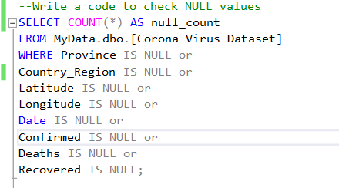
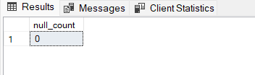
Q1. Write a code to check NULL values

Slide 4
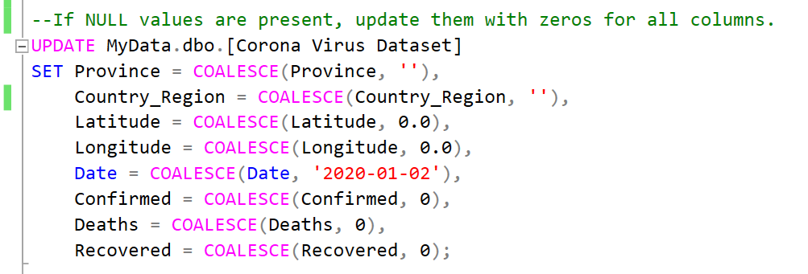
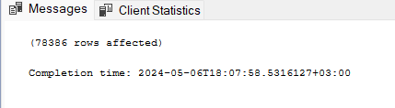
Q2. If NULL values are present, update them with zeros for all columns.

Slide 5
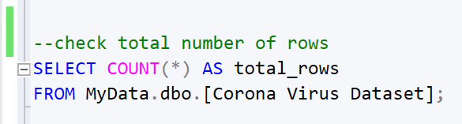

Q3. check total number of rows

Slide 6
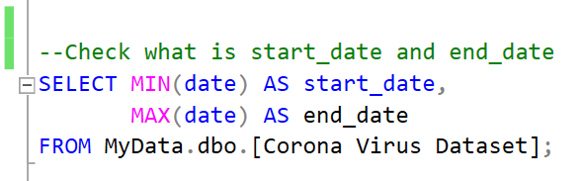

Q4. Check what is start date and end date

Slide 7
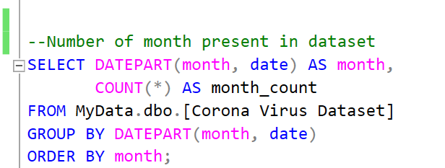
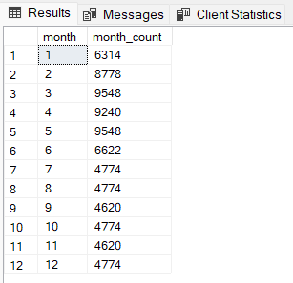
Q5. Number of month present in dataset

Slide 8
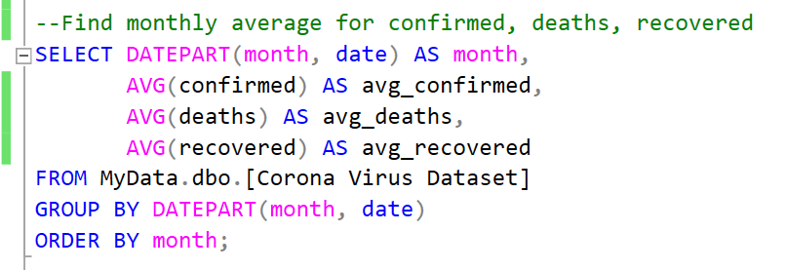
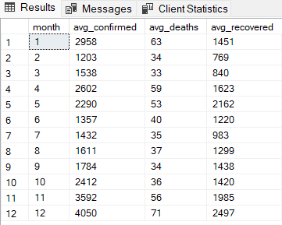
Q6. Find monthly average for confirmed, deaths, recovered

Slide 9
Q6. Find monthly average for confirmed, deaths, recovered

Slide 10
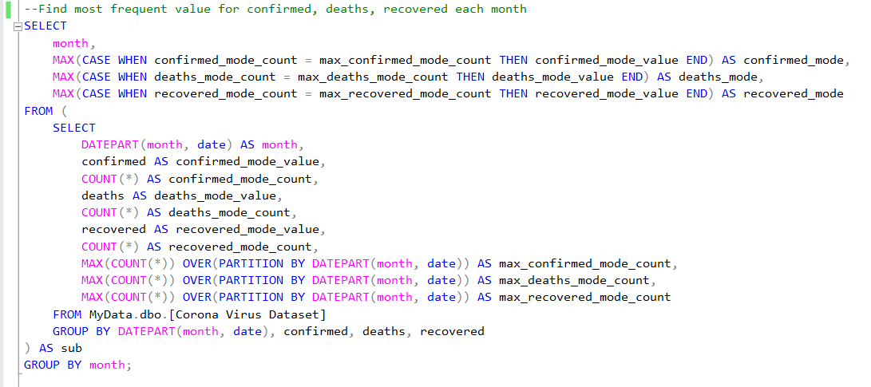
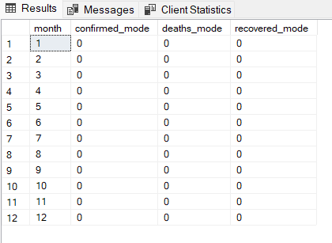
Q7. Find most frequent value for confirmed, deaths, recovered each month

Slide 11
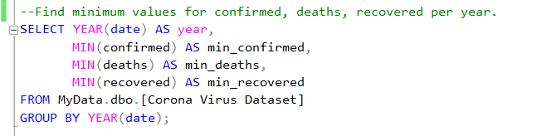
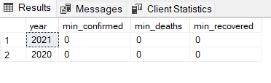
Q8. Find minimum values for confirmed, deaths, recovered per year

Slide 12
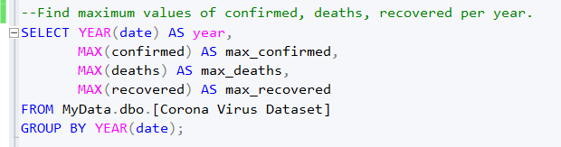
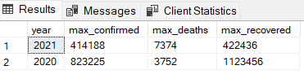
Q9. Find maximum values of confirmed, deaths, recovered per year

Slide 13
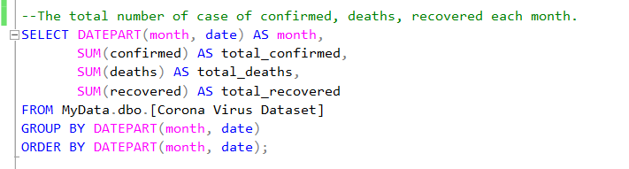
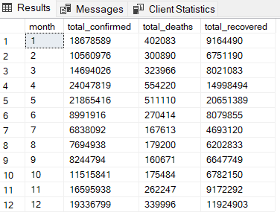
Q10. The total number of case of confirmed, deaths, recovered each month

Slide 14
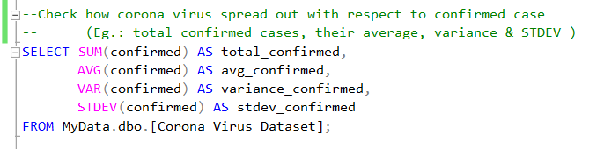

Q11. Check how corona virus spread out with respect to confirmed case

Slide 15
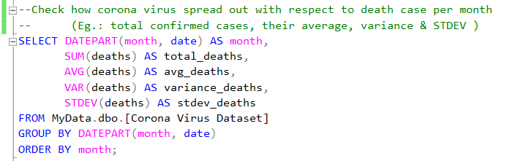
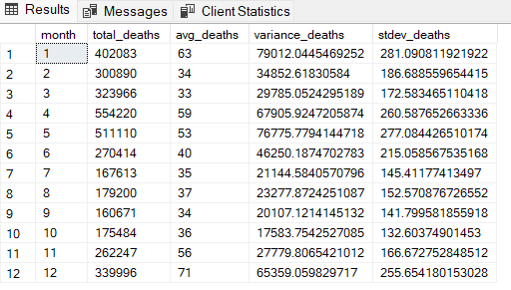
Q12. Check how corona virus spread out with respect to death case per month

Slide 16
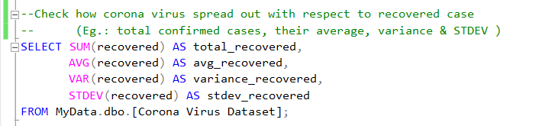

Q13. Check how corona virus spread out with respect to recovered case

Slide 17
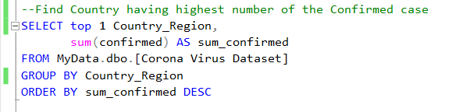

Q14. Find Country having highest number of the Confirmed case

Slide 18
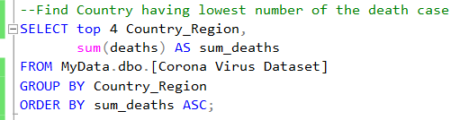
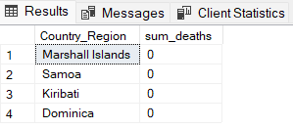
Q15. Find Country having lowest number of the death case

Slide 19
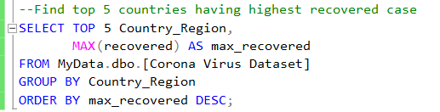
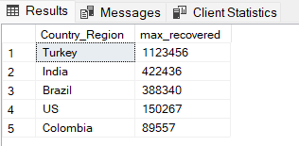
Q16. Find top 5 countries having highest recovered case

Slide 20
Thank You.

